Slide 1
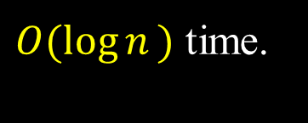
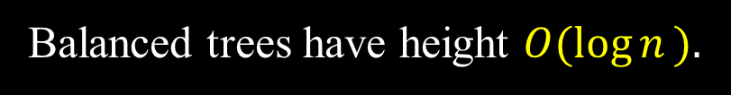

Balanced Trees
Balanced trees have height $O(\log{n}⁡).$
Height-balanced trees
At each node, height of left and right subtrees are “close”.
e.g. AVL trees, B-trees, red-black trees, splay trees
Weight-balanced trees
At each node, number of nodes in left and right subtrees
are “close”.
e.g. BB[$α$] trees
Search, Predecessor, Successor, Minimum, Maximum
$O(\log{n}⁡)$ time.
Insert and Delete may have to rebalance the tree.

Slide 2
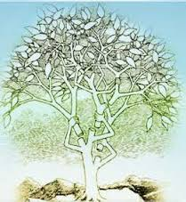
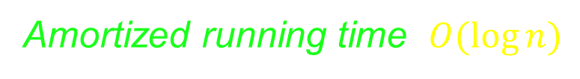
Splay Trees
Self-adjusting binary search tree (Sleator & Tarjan 1985)
Recently accessed elements
are quick to access again.
Amortized running time: $O(log⁡n)$
Averaged running time per operation
over a worst-case sequence of
operations.

Slide 3
Advantages
Simple implementation –– easier to implement than other
self-balancing BSTs such as red-black trees and AVL trees.
Comparable performance –– average-case performance
is as efficient as other self-balancing BSTs.
Small memory footprint –– no need to store bookkeeping data.
Working well with nodes containing identical keys.

Slide 4
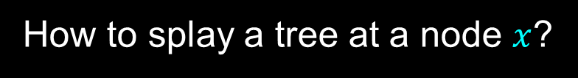
Splaying
Restructuring heuristics:
Performs rotations bottom-up along the access path
and moves the accessed item all the way to the root.
Does the rotations in pairs, in an order depending on
the structure of the access path.
How to splay a tree at a node $x$?
Repeat a sequence of splaying steps until $x$ is the root of tree.
zig, zig-zig, or zig-zag.

Slide 5
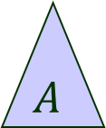



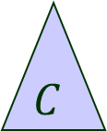
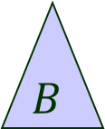



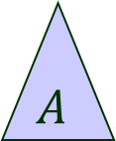



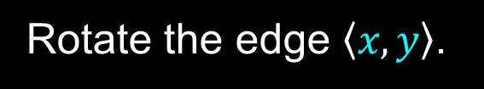

Case 1: zig
Parent $y$of $x$is the tree root.
Rotate the edge $\left\langle x, y\right\rangle$.
$$y$$
$$x$$
rotate right
$$y$$
$$C$$
$$A$$
$$x$$
$$B$$
$$C$$
$$A$$
$$B$$
$$>y$$
$$<x$$
$$>x \&<y$$
Terminal case.

Slide 6


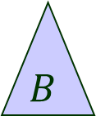




Case 1: zig (cont’d)
$$x$$
$$y$$
$$x$$
$$A$$
$$y$$
$$C$$
rotate left
$$B$$
$$C$$
$$A$$
$$B$$

Slide 7



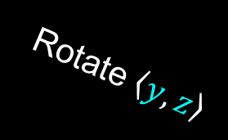














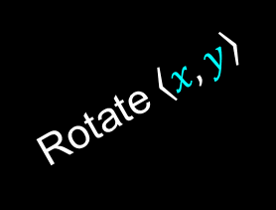



Case 2: zig-zig
a) Parent $y$ of $x$ is not the root ($x$ has grandparent $z$).
b) $x$ and $y$ are both left or both right children.
Symmetric rotations when $x$ and $y$ are both right children.
$$x$$
$$z$$
$$D$$
$$A$$
$$y$$
$$y$$
$$y$$
$$B$$
$$C$$
$$z$$
$$x$$
Rotate $\left\langle y, z\right\rangle$
$$x$$
$$z$$
$$A$$
$$B$$
Rotate $\left\langle x, y\right\rangle$
$$C$$
$$D$$
$$A$$
$$B$$
$$C$$
$$D$$

Slide 8


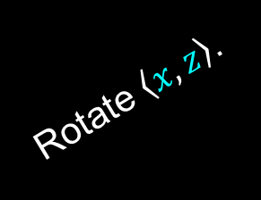



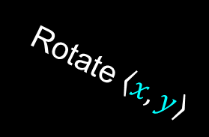








Case 3: zig-zag
a) Parent $y$ of $x$ is not the root ( $x$ has grandparent $z$).
b) $x$ is a left child and $y$ is a right child, or vice versa.
Symmetric rotations when $x$ is a left child and $y$ is a right child.
$$z$$
$$x$$
$$z$$
$$y$$
$$D$$
$$y$$
$$z$$
$$x$$
$$x$$
$$D$$
$$A$$
$$B$$
$$C$$
$$D$$
$$A$$
Rotate $\left\langle x, y\right\rangle$
$$B$$
$$C$$
$$y$$
$$C$$
Rotate $\left\langle x, z\right\rangle$.
$$A$$
$$B$$

Slide 9

Time for Splaying a Node
$(d)$: where $d$ is the depth of the node $x$.
Proportional to the time to access the item stored in $x$.
Effects of splaying:
Moves $x$ to the root.
Roughly halves the depth of every node along the access path
(shown in the next two examples).

Slide 10


































Example 1 – Splay Step 1
$$i$$
$$i$$
$$h$$
J
$$h$$
J
$$g$$
$$I$$
$$g$$
$$I$$
$$f$$
$$H$$
$$f$$
$$H$$
Zig-zig
$$A$$
$$e$$
$$A$$
$$e$$
$$d$$
$$G$$
$$d$$
$$G$$
$$c$$
$$a$$
$$B$$
Rotation 1
$$B$$
$$b$$
$$F$$
$$C$$
Rotation 2
Splay
$$b$$
$$D$$
$$a$$
After
rotation 1
$$c$$
$$E$$
$$E$$
$$F$$
$$C$$
$$D$$

Slide 11
















Splay Step 2
$$i$$
$$i$$
$$h$$
J
$$h$$
J
$$g$$
$$g$$
$$I$$
$$I$$
$$f$$
$$H$$
$$f$$
$$H$$
Zig-zag
$$A$$
$$a$$
$$A$$
$$e$$
$$d$$
$$G$$
$$d$$
$$e$$
Rotation 1
$$a$$
$$B$$
$$B$$
$$F$$
$$G$$
$$b$$
$$F$$
$$b$$
$$c$$
$$E$$
$$c$$
$$E$$
$$C$$
$$D$$
$$C$$
$$D$$

Slide 12









Splay Step 3
$$i$$
$$i$$
$$h$$
J
$$h$$
J
$$g$$
$$a$$
$$I$$
$$I$$
$$f$$
$$H$$
$$f$$
Zig-zag
$$g$$
$$A$$
$$a$$
$$A$$
$$d$$
$$e$$
$$H$$
$$d$$
$$e$$
$$B$$
$$F$$
$$G$$
$$B$$
$$F$$
$$G$$
$$b$$
$$b$$
$$c$$
$$c$$
$$E$$
$$E$$
$$C$$
$$D$$
$$C$$
$$D$$

Slide 13


Splay Step 4
$$a$$
$$i$$
$$h$$
J
$$a$$
$$I$$
$$f$$
$$f$$
Zig-zig
$$g$$
$$h$$
$$A$$
$$A$$
$$g$$
$$i$$
$$d$$
$$e$$
$$H$$
$$d$$
$$e$$
$$H$$
$$I$$
J
$$B$$
$$F$$
$$G$$
$$B$$
$$b$$
$$b$$
$$F$$
$$G$$
$$c$$
$$c$$
E
$$E$$
$$C$$
$$D$$
$$C$$
$$D$$

Slide 14


















Example 2 – All zig-zig Steps
$$g$$
$$g$$
$$f$$
$$H$$
$$f$$
$$H$$
$$e$$
$$G$$
$$e$$
$$G$$
$$d$$
$$F$$
$$d$$
$$F$$
Splay
$$c$$
$$E$$
$$a$$
$$E$$
$$b$$
$$D$$
$$A$$
$$b$$
$$a$$
$$C$$
$$B$$
$$c$$
$$A$$
$$B$$
$$C$$
$$D$$

Slide 15















Example 2 (cont’d)
$$g$$
$$g$$
$$f$$
$$H$$
$$f$$
$$H$$
$$e$$
Splay
$$G$$
$$a$$
$$G$$
$$d$$
$$F$$
$$A$$
$$a$$
$$E$$
$$d$$
$$b$$
$$e$$
$$A$$
$$b$$
$$E$$
$$F$$
$$B$$
$$c$$
$$B$$
$$c$$
$$C$$
$$D$$
$$C$$
$$D$$

Slide 16















Example 2 (cont’d)
$$g$$
$$a$$
Splay
$$f$$
$$H$$
$$A$$
$$f$$
$$a$$
$$G$$
$$d$$
$$g$$
$$A$$
$$d$$
$$G$$
$$H$$
$$b$$
$$e$$
$$e$$
$$E$$
$$F$$
$$b$$
$$B$$
$$c$$
$$E$$
$$F$$
$$B$$
$$c$$
$$C$$
$$D$$
$$C$$
$$D$$

Slide 17











Example 3 – All zig-zag Steps
$$g$$
$$g$$
$$f$$
$$H$$
$$f$$
$$H$$
$$A$$
$$e$$
$$A$$
$$e$$
$$d$$
$$G$$
$$d$$
$$G$$
$$B$$
$$c$$
$$B$$
$$a$$
$$b$$
$$F$$
$$b$$
$$c$$
$$C$$
$$a$$
$$C$$
$$D$$
$$E$$
$$F$$
$$D$$
$$E$$

Slide 18















Example 3 (cont’d)
$$g$$
$$g$$
$$f$$
$$H$$
$$f$$
$$H$$
$$A$$
$$a$$
$$A$$
$$e$$
$$d$$
$$G$$
$$d$$
$$e$$
$$B$$
$$a$$
$$B$$
$$b$$
$$c$$
$$G$$
$$F$$
$$b$$
$$c$$
$$C$$
$$D$$
$$E$$
$$C$$
$$D$$
$$E$$
$$F$$

Slide 19

















Example 3 (cont’d)
$$a$$
$$g$$
$$f$$
$$H$$
$$A$$
$$a$$
$$f$$
$$g$$
$$d$$
$$e$$
$$A$$
$$d$$
$$e$$
$$H$$
$$B$$
$$b$$
$$c$$
$$G$$
$$F$$
$$B$$
$$b$$
$$c$$
$$G$$
$$C$$
$$D$$
$$E$$
$$C$$
$$D$$
$$E$$
$$F$$

Slide 20

Data Access
All BST update operations can be implemented by splaying.
Access: if the item is stored in node $x$, splay at $x$;
otherwise, splay at the last non-null node (i.e., the
leaf node) on the search path.
Find 80:
70
50
Splay at 70
50
90
30
60
30
60
100
10
40
90
40
10
20
70
100
20
15
last non-null
node
15

Slide 21
Insertion
1. Search for the item.
2. Create a new node containing the item if not in the tree.
3. Splay the tree at the new node.
BST insertion + Splaying.
Insert 80:
80
50
60
90
30
60
50
70
100
10
40
90
30
20
70
100
10
40
15
80
20
15

Slide 22




Joining Two BSTs
Two BSTs $S$ and $T$ such that all items in $S$ are less than
those in $T$. Combine $S$ and $T$ into a single tree.
Access the largest item in $S$. It is stored in node $x$ .
After the access:
$x$ is at the root.
$x$ has no right child.
2. Making $T$ the right subtree of this root.

Slide 23


Example 4 (of Join)
$S$:
50
$T$:
120
30
60
110
140
10
40
90
20
70
100
15
100
100
120
50
50
90
90
110
140
30
30
10
40
60
10
40
60
20
70
20
70
15
15

Slide 24




Deletion
1. Search for the item (stored at $x$ with parent $y$).
2. Replace $x$ by the join of the left and right subtrees of $x$.
3. Splay at $y$ (or the last node on the search path if the item is not found).
Example Delete 30:
80
80
60
Join children
of 30
60
90
90
$$y$$
$$y$$
50
70
100
50
70
100
$$x$$
20
30
40
10
40
10
20
15
15

Slide 25
Example 5 (cont’d)
80
50
60
Splay at 50
20
60
90
$$y$$
50
10
40
80
70
100
20
15
70
90
40
10
100
15
For more on splay trees, we refer to the following paper (where all
examples but the joint one are from).
D. D. Sleator and R. E. Tarjan. Self-adjusting binary search trees.
Journal of the ACM, 32(3):652-686, 1985.

